Slide 1
The MOOC and The Library:
How Massive Open Online Courses Could Change the Future of Library Instruction
Laura Burt-Nicholas, North Park University,

Slide 8
Overview
What is a MOOC?
MOOCs and libraries
Library instruction: how will MOOCs change our plans?

Slide 9
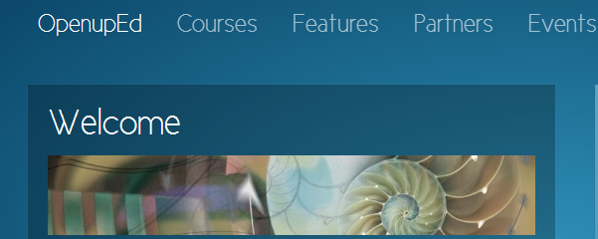
What’s a MOOC?

Slide 10
MOOCs: Personal Experience

Slide 11
Personal Experience, Part 2

Slide 12
Personal Experience, Part 3

Slide 13
Who Takes MOOCs?

Slide 14
MOOCs by the Numbers
Kolowich, Steve. “The Professors Behind the MOOC Hype.” The Chronicle of Higher Education 18 Mar. 2013. Web. 21 Mar. 2013.

Slide 15
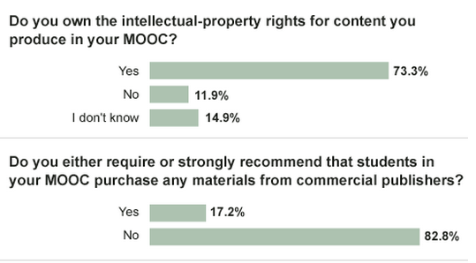
MOOCs by the Numbers
Kolowich, Steve. “The Professors Behind the MOOC Hype.”

Slide 16
MOOCs by the Numbers
Kolowich, Steve. “The Professors Behind the MOOC Hype.”

Slide 17
MOOCs by the Numbers: Research
Zazani, Eleni. “Our #edcmooc Paths to Finding Information - Results.” Eleni’s First Steps. Web. 1 May 2013., Creative Commons License.

Slide 18
MOOCs for Credit?
From Inside Higher Ed, Jan 2013
From “The Professors Behind the MOOC Hype.”

Slide 19
MOOCs as Vehicle for Transformation

Slide 20
Where does this leave librarians?
Faculty Education about copyright
Open Access
Student Research

Slide 21
Information Literacy Programs and General Education
Fast Poll: please raise your hand if your library’s Information Literacy Program (or instruction) is primarily delivered through general education courses?

Slide 22
MOOC Teaching Styles
Not active learning
Does not involve research
Often assessments are simple, and not reviewed by profs: multiple choice quizzes and exams, don’t give students a chance to demonstrate more learning.
Sense of community?

Slide 23
Teaching the One-Shot Session

Slide 24
Connectivism
Drexler, Wendy. Networked Student. Film. http://www.youtube.com/watch?v=XwM4ieFOotA

Slide 25
Connectivism: A Model for Future MOOCs?

Slide 26
Questions?
Laura Burt-Nicholas
lburt@northpark.edu

Slide 27
Citations
Barlow, Amy. “The Librarian of MOOC.” Chasing Reference. Web. 26 Oct. 2012.
Creed-Dikeogu, Gloria, and Carolyn Clark. “Are You MOOC-ing Yet? A Review for Academic Libraries.” Kansas Library Association College and University Libraries Section Proceedings 3.0 (2013): 9–13. newprairiepress.org. Web. 10 Apr. 2013.
Davidson, Cathy. “If We Profs Don’t Reform Higher Ed, We’ll Be Re-Formed (and We Won’t Like It).” HASTAC: Humanities Arts Sciences and Technology Advanced Collaboratory 13 Jan. 2013. Web. 16 Jan. 2013.
Drexler, Wendy. Networked Student. Film.
Fain, Paul. “Gates Seeks Development of Remedial Ed MOOCs.” Inside Higher Ed. Web. 20 Nov. 2012.
Guder, Christopher. “Patrons and Pedagogy: A Look at the Theory of Connectivism.” Public Services Quarterly 6.1 (2010): 36–42. EBSCOhost. Web.
Jaschik, Scott. “MOOCs for Credit.” Inside Higher Ed. 23 Jan. 2013. Web. 23 Jan. 2013.
Jordan, Katy. “MOOC Completion Rates.” 12 Apr. 2013. Web. 26 Sept. 2012.
Kolowich, Steve. “Early Demographic Data Hints at What Type of Student Takes a MOOC.” Inside Higher Ed. 5 June 2012. Web. 20 Nov. 2012.

Slide 28
Citations
Kolowich, Steve. “The Professors Behind the MOOC Hype.” The Chronicle of Higher Education 18 Mar. 2013. Web. 21 Mar. 2013.
Lederman, Doug. “Educause, Gates Unveil Grants for ‘Breakthrough’ Models.” Inside Higher Ed. Web. 20 Nov. 2012.
Mahraj, Katy. “Using Information Expertise to Enhance Massive Open Online Courses.” Public Services Quarterly 8.4 (2012): 359–368. EBSCOhost. Web.
McBride, Mark F. “Reconsidering Information Literacy in the 21st Century: The Redesign of an Information Literacy Class.” Journal of Educational Technology Systems 40.3 (2011): 287–300. Print.
Shirky, Clay. “Your Massively Open Offline College Is Broken.” The Awl 7 Feb. 2013.
Tuchler, Margot. “Duke Librarians Aid MOOCs with Technology, Research.” The Duke Chronicle. 4 Apr. 2013. Web. 22 Apr. 2013.
University of Pennsylvania, and OCLC Research. “MOOCs and Libraries: Massive Opportunity or Overwhelming Challenge?” 9 Apr. 2013. Web. 26 Apr. 2013.
Zazani, Eleni. “Our #edcmooc Paths to Finding Information - Results.” Eleni’s First Steps. Web. 1 May 2013.

